Slide 1
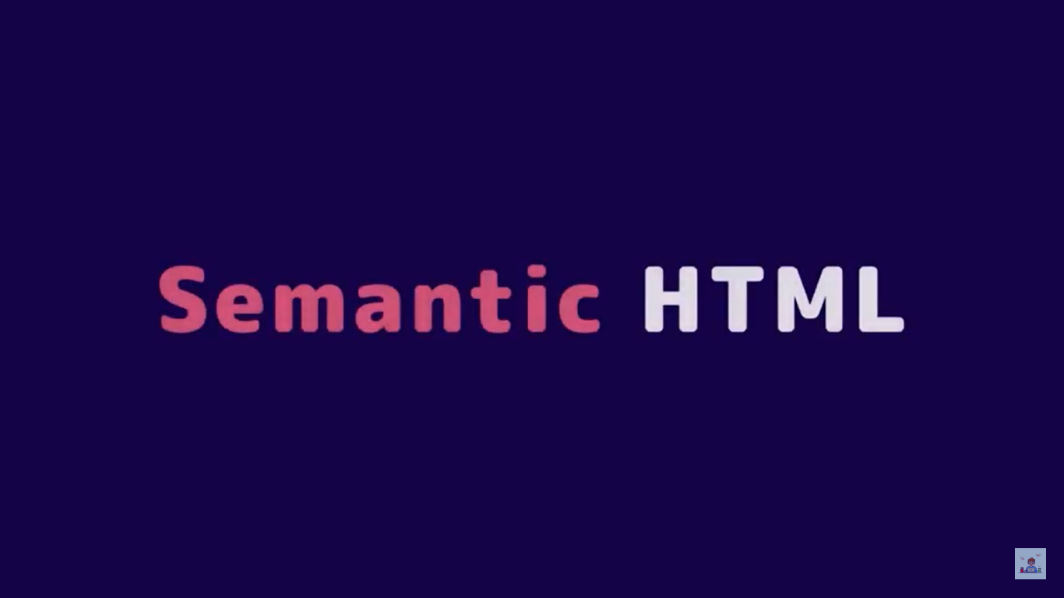
Semantic tags

Slide 2
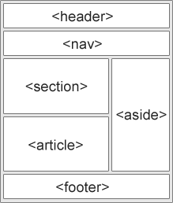

Slide 3
HTML <header> Element
The <header> element represents a container for introductory content or a set of navigational links.
A <header> element typically contains:
one or more heading elements (<h1> - <h6>)
logo or icon
authorship information
Note: You can have several <header> elements in one HTML document. However, <header> cannot be placed within a <footer>, <address> or another <header> element.

Slide 4
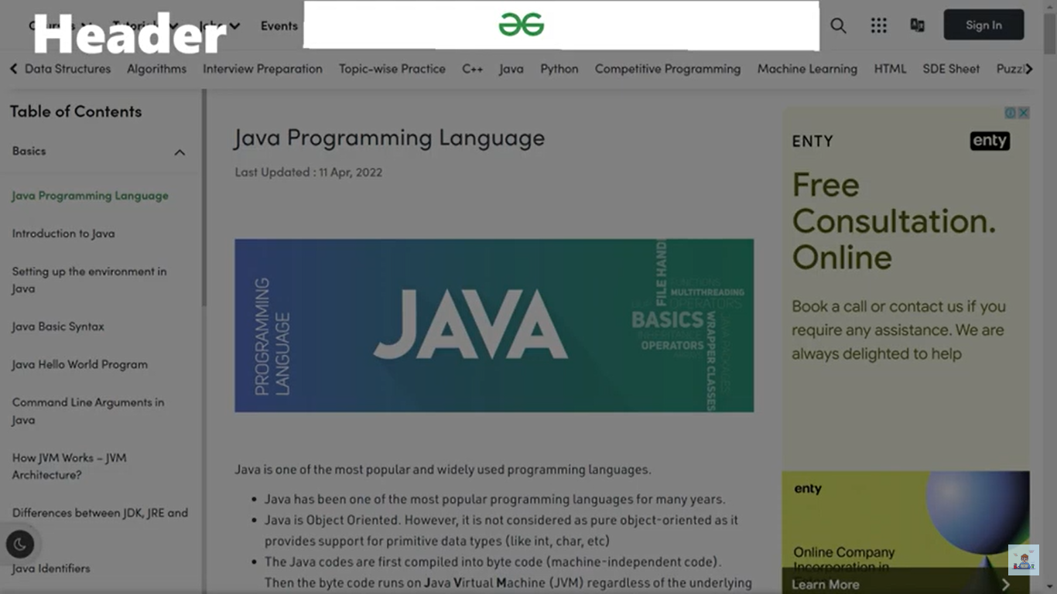

Slide 5
<!DOCTYPE html>
<html>
<body>
<article>
<header>
<h1>What Does WWF Do?</h1>
<p>WWF's mission:</p>
</header>
<p>WWF's mission is to stop the degradation of our planet's natural environment, and build a future in which humans live in harmony with nature.</p>
</article>
</body>
</html>

Slide 6
output
What Does WWF Do?
WWF's mission:
WWF's mission is to stop the degradation of our planet's natural environment, and build a future in which humans live in harmony with nature.

Slide 7
HTML <nav> Element
The <nav> element defines a set of navigation links.
Notice that NOT all links of a document should be inside a <nav> element. The <nav> element is intended only for major blocks of navigation links.
Browsers, such as screen readers for disabled users, can use this element to determine whether to omit the initial rendering of this content.

Slide 8
<!DOCTYPE html>
<html>
<body>
<nav>
<a href="/html/">HTML</a> |
<a href="/css/">CSS</a> |
<a href="/js/">JavaScript</a> |
<a href="/jquery/">jQuery</a>
</nav>
</body>
</html>
HTML | CSS | JavaScript | jQuery

Slide 9
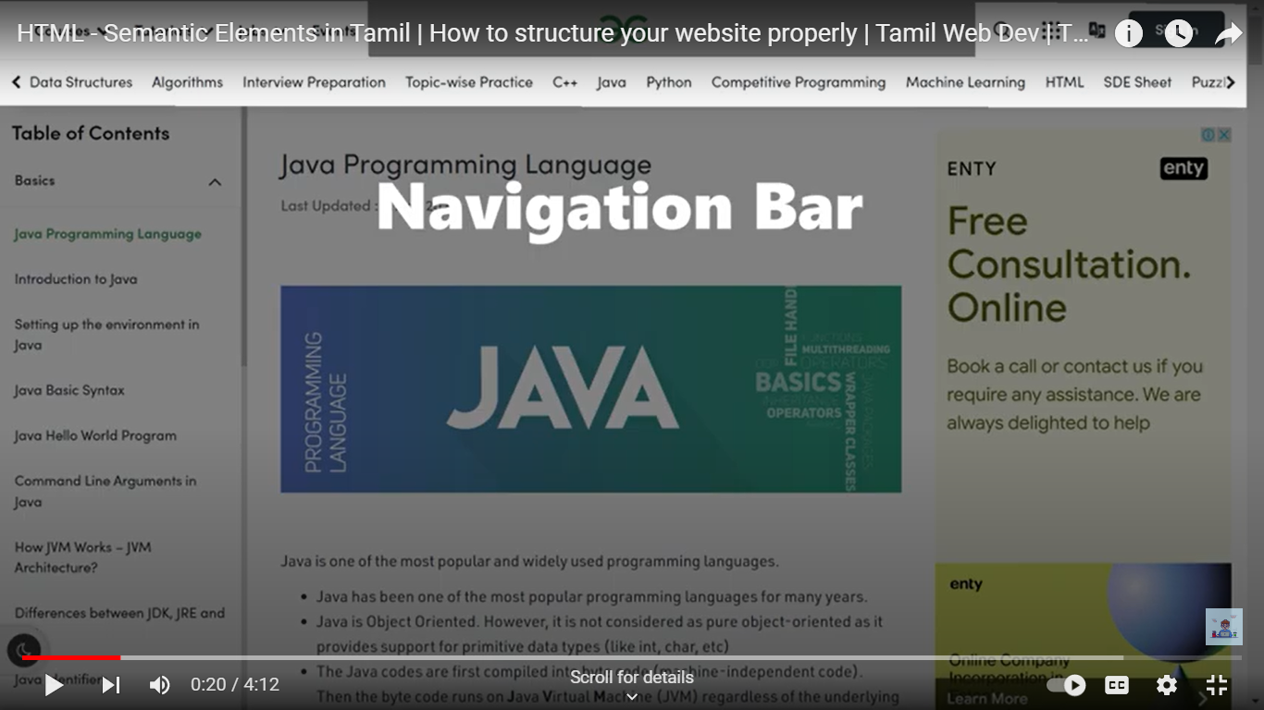

Slide 10
HTML <section> Element
The <section> element defines a section in a document.
According to W3C's HTML documentation: "A section is a thematic grouping of content, typically with a heading."
Examples of where a <section> element can be used:
Chapters
Introduction
News items
Contact information
A web page could normally be split into sections for introduction, content, and contact information.

Slide 11
<!DOCTYPE html>
<html>
<body>
<section>
<h1>WWF</h1>
<p>The World Wide Fund for Nature (WWF) is an international organization working on issues regarding the conservation, research and restoration of the environment, formerly named the World Wildlife Fund. WWF was founded in 1961.</p>
</section>
<section>
<h1>WWF's Panda symbol</h1>
<p>The Panda has become the symbol of WWF. The well-known panda logo of WWF originated from a panda named Chi Chi that was transferred from the Beijing Zoo to the London Zoo in the same year of the establishment of WWF.</p>
</section>
</body>
</html>
WWF
The World Wide Fund for Nature (WWF) is an international organization working on issues regarding the conservation, research and restoration of the environment, formerly named the World Wildlife Fund. WWF was founded in 1961.
WWF's Panda symbol
The Panda has become the symbol of WWF. The well-known panda logo of WWF originated from a panda named Chi Chi that was transferred from the Beijing Zoo to the London Zoo in the same year of the establishment of WWF.

Slide 12
HTML <article> Element
The <article> element specifies independent, self-contained content.
An article should make sense on its own, and it should be possible to distribute it independently from the rest of the web site.
Examples of where the <article> element can be used:
Forum posts
Blog posts
User comments
Product cards
Newspaper articles

Slide 13
<!DOCTYPE html>
<html>
<body>
<h1>The article element</h1>
<article>
<h2>Google Chrome</h2>
<p>Google Chrome is a web browser developed by Google, released in 2008. Chrome is the world's most popular web browser today!</p>
</article>
<article>
<h2>Mozilla Firefox</h2>
<p>Mozilla Firefox is an open-source web browser developed by Mozilla. Firefox has been the second most popular web browser since January, 2018.</p>
</article>
<article>
<h2>Microsoft Edge</h2>
<p>Microsoft Edge is a web browser developed by Microsoft, released in 2015. Microsoft Edge replaced Internet Explorer.</p>
</article>
</body>
</html>

Slide 14
The article element
Google Chrome
Google Chrome is a web browser developed by Google, released in 2008. Chrome is the world's most popular web browser today!
Mozilla Firefox
Mozilla Firefox is an open-source web browser developed by Mozilla. Firefox has been the second most popular web browser since January, 2018.
Microsoft Edge
Microsoft Edge is a web browser developed by Microsoft, released in 2015. Microsoft Edge replaced Internet Explorer.

Slide 15
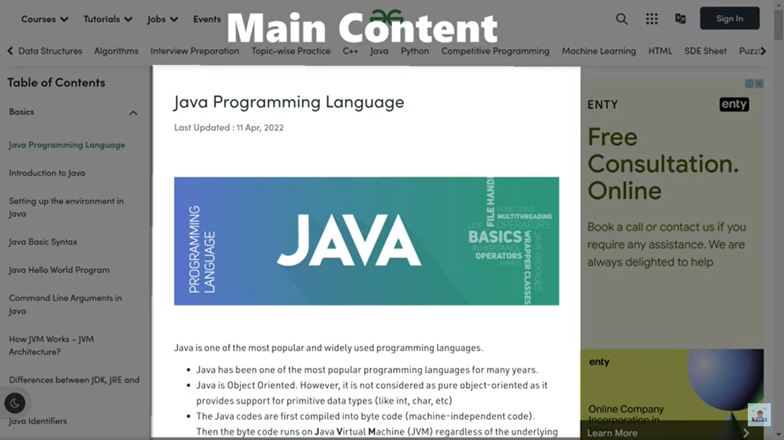

Slide 16
HTML <footer> Element
The <footer> element defines a footer for a document or section.
A <footer> element typically contains:
authorship information
copyright information
contact information
sitemap
back to top links
related documents
You can have several <footer> elements in one document.

Slide 17
<!DOCTYPE html>
<html>
<body>
<footer>
<p>Author: Hege Refsnes</p>
<p><a href="mailto:hege@example.com">hege@example.com</a></p>
</footer>
</body>
</html>

Slide 18
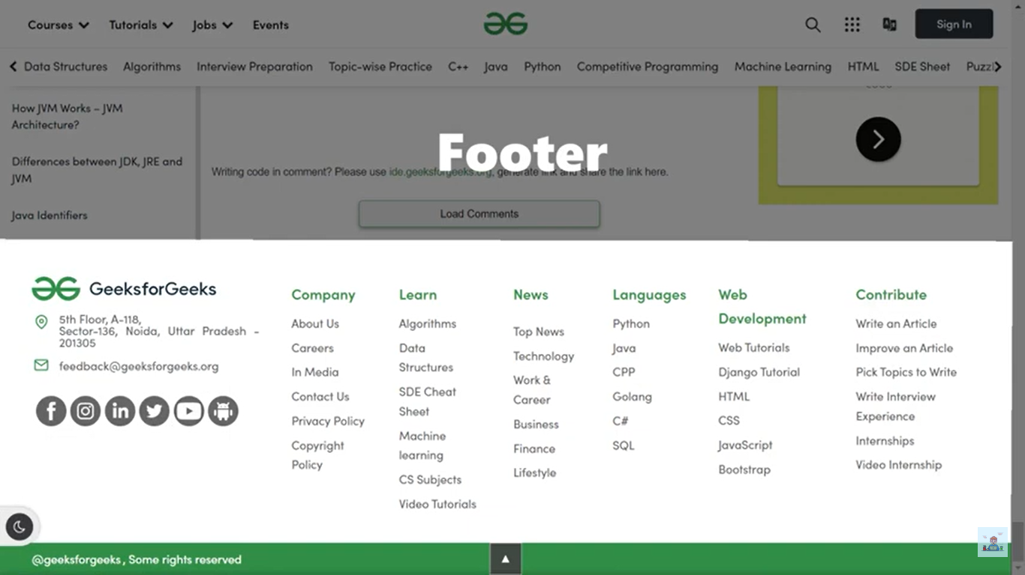

Slide 19
HTML <aside> Element
The <aside> element defines some content aside from the content it is placed in (like a sidebar).
The <aside> content should be indirectly related to the surrounding content.

Slide 20
<!DOCTYPE html>
<html>
<head>
<style>
aside {
width: 30%;
padding-left: 15px;
margin-left: 15px;
float: right;
font-style: italic;
background-color: lightgray;
}
</style>
</head>
<body>
<p>My family and I visited The Epcot center this summer. The weather was nice, and Epcot was amazing! I had a great summer together with my family!</p>
<aside>
<p>The Epcot center is a theme park at Walt Disney World Resort featuring exciting attractions, international pavilions, award-winning fireworks and seasonal special events.</p>
</aside>
</body>
</html>

Slide 21
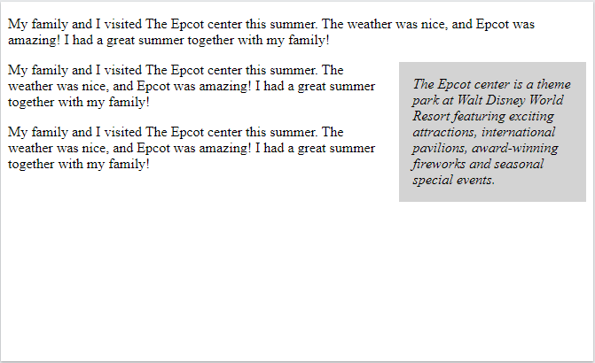

Slide 22
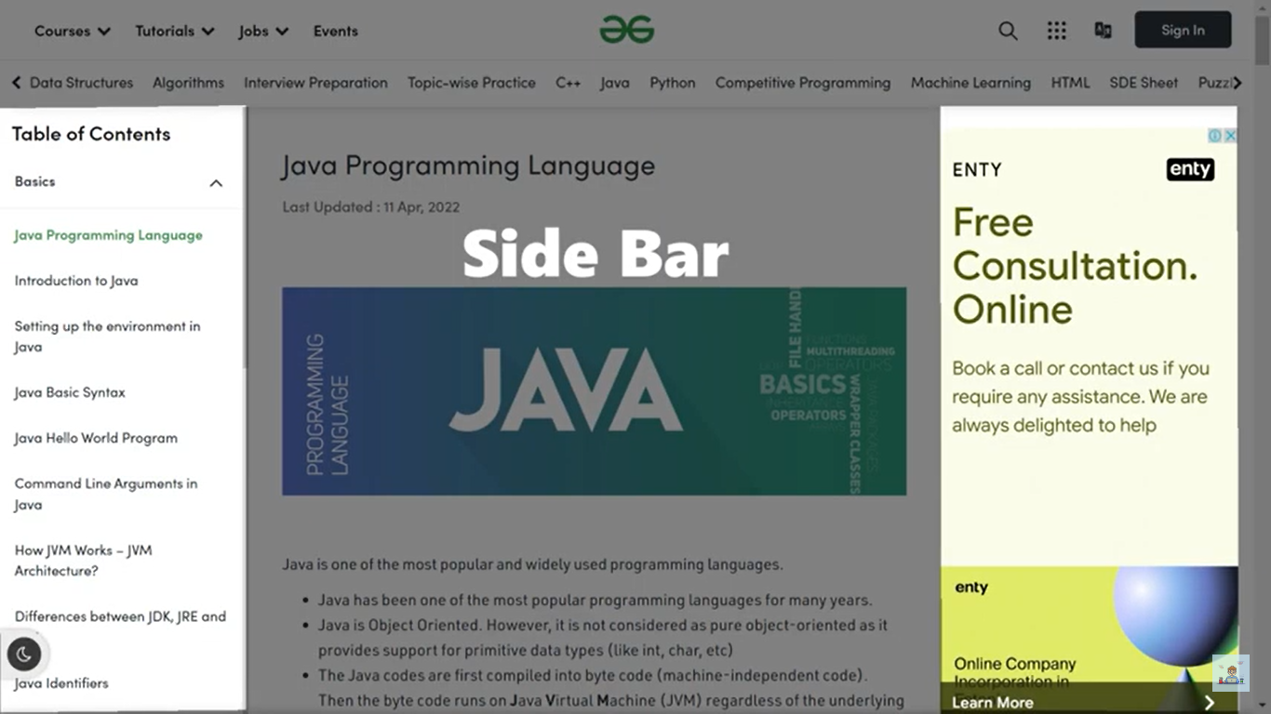

Slide 23
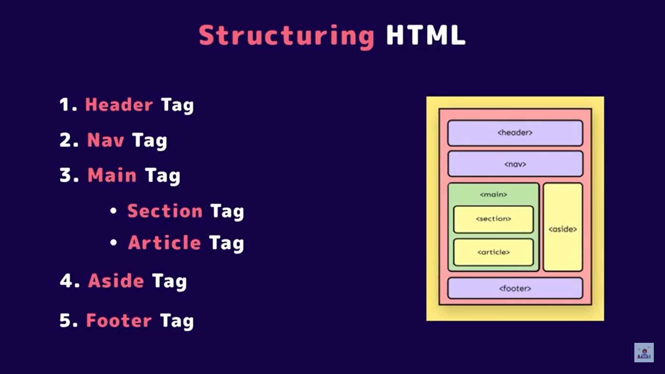

Slide 24
